Slide 1
Continuous Database Integration
with Flyway and Jenkins
Sandra Kosmalla
Softwerkskammer Dortmund, 2013-09-25

Slide 2
Agenda
Continuous Database Integration (CDBI)
Flyway
Demo of Flyway in combination with Jenkins

Slide 3
Continuous Database Integration
Motivation for CDBI
Definition of CDBI
How to set up CDBI

Slide 4
Motivation for CDBI
One shared test database for all developer.
Nobody knows which database migration script was run on which database instance.
Test database differs from productive database
Database migration scripts are distributed in ticket system, developer's system etc.

Slide 5
Definition of CDBI
„Continous Database Integration (CDBI) is the process of rebuilding your database and test data any time a change is applied to a project's version control repository“
(from Continuous Integration by Paul M. Duvall, Steve Matyas and Andrew Glover)

Slide 6
How To Set Up CDBI
Treat database code like a normal source code
  Put all database assets (DDL, DML, configurations, test data, stored procedures, functions etc) in your version control system.
  Test your database code after every change.
Give every developer his own database / Make test database being similar to the productiv database.
  Set up the database by build scripts.
If you have a database team, integrate these members in your development teams.

Slide 7
Flyway
What is Flyway?
How Does Flyway Work?
How to write scripts for migration with Flyway?
How to use Flyway?

Slide 8

What is Flyway?
Database migration framework based on Java
Recreate a database from scratch
Make it clear at all times what state a database is in
Migrate in a deterministic way from your current version of the database to a newer one
Two migrations:
    SQL migration (most common)
    Java migration (for advanced changes like LOBs)
Current version: 2.2.1
Homepage: http://flywaydb.org/
Twitter: @flywaydb

Slide 9
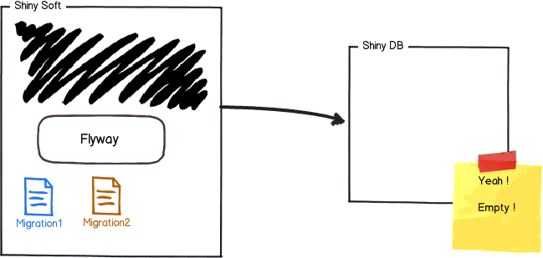
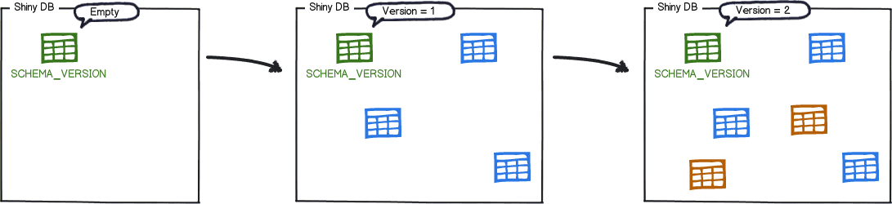
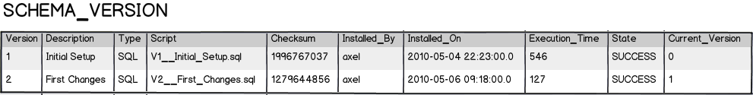
How does Flyway work?
Reference: flywaydb.org

Slide 10
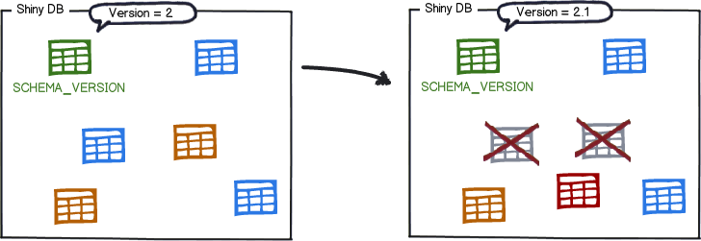
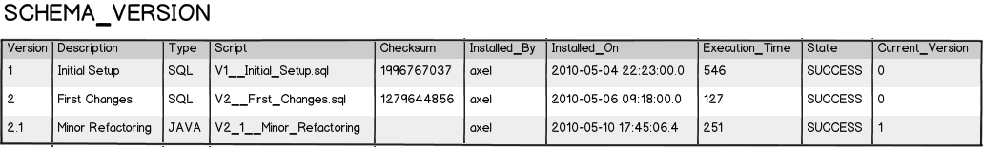
How does Flyway work?
Reference: flywaydb.org

Slide 11
Migration Script
Two possibilities
  SQL scripts
  Java classes

Slide 12
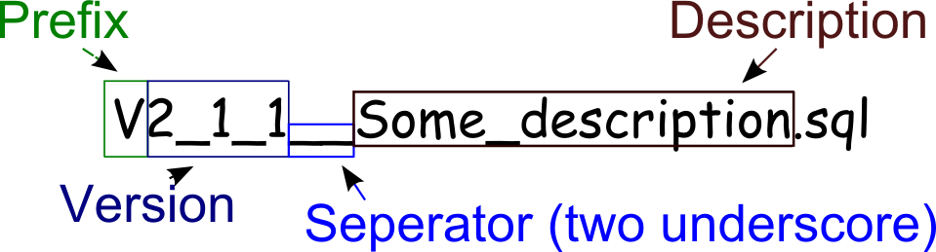
SQL Migration
Typical usage
  DDL changes (CREATE/ALTER/DROP statements for TABLES,VIEWS,TRIGGERS,SEQUENCES,...)
  Simple reference data changes (CRUD in reference data tables)
  Simple bulk data changes (CRUD in regular data tables)
Naming

Slide 13
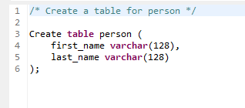
SQL Migration
Syntax
  Single or multi line statements
  Flexible placeholder replacement
  Single (–) or multi line (/* */) comments
  Database-specific SQL syntax extensions
Example

Slide 14
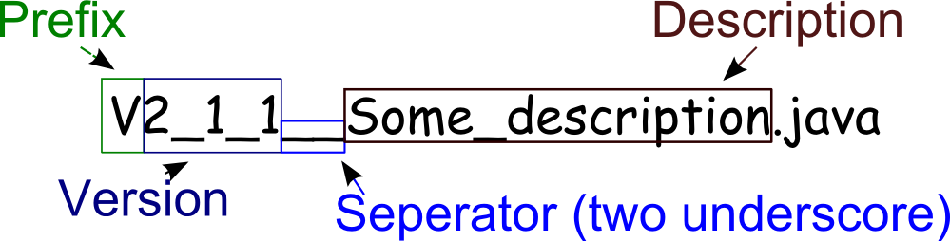
Java Migration
Typical usage
  BLOB & CLOB changes
  Advanced bulk data changes (Recalculations, advanced format changes, …)
Naming

Slide 15
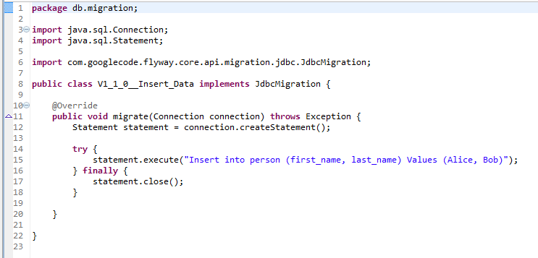
Java Migration
Sample

Slide 16
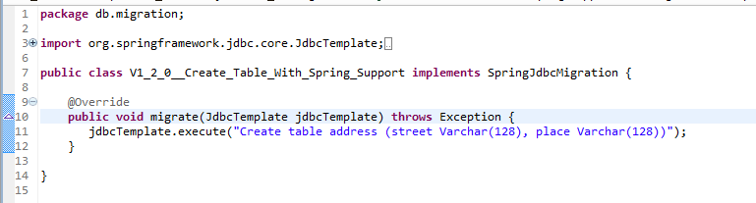
Java Migration
Sample with Spring support

Slide 17
Using Flyway
Flyway Clients:
    Java API
    Maven Plugin
    Command-line tool
    Gradle Plugin
    Ant task

Slide 18
Demo Setup
Jenkins 1.530
Installed Jenkins plugins:
    Repository Connector Plugin
    Build Pipeline Plugin
Maven 3.0.4
Flyway 2.2.1
MySQL 5.5
Nexus 2.6.3

Slide 19
References
Continuous Integration by Paul M. Duvall, Steve Matyas and Andrew Glover
Flyway Documentation http://flywaydb.org/documentation/migration/
http://flywaydb.org/getstarted/

